Slide 1
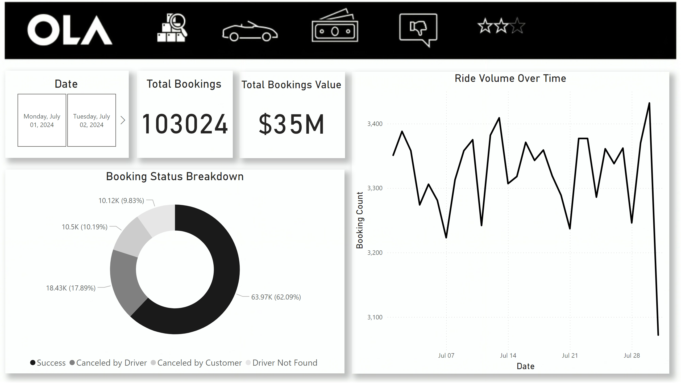
Slide 1
Notes:
actionButton
No alt text provided
actionButton
No alt text provided
actionButton
No alt text provided
actionButton
No alt text provided
actionButton
No alt text provided
Ride Volume Over Time
No alt text provided
Booking Status Breakdown
No alt text provided
Date
No alt text provided
Total Bookings
No alt text provided
Total Bookings Value
No alt text provided

Slide 2
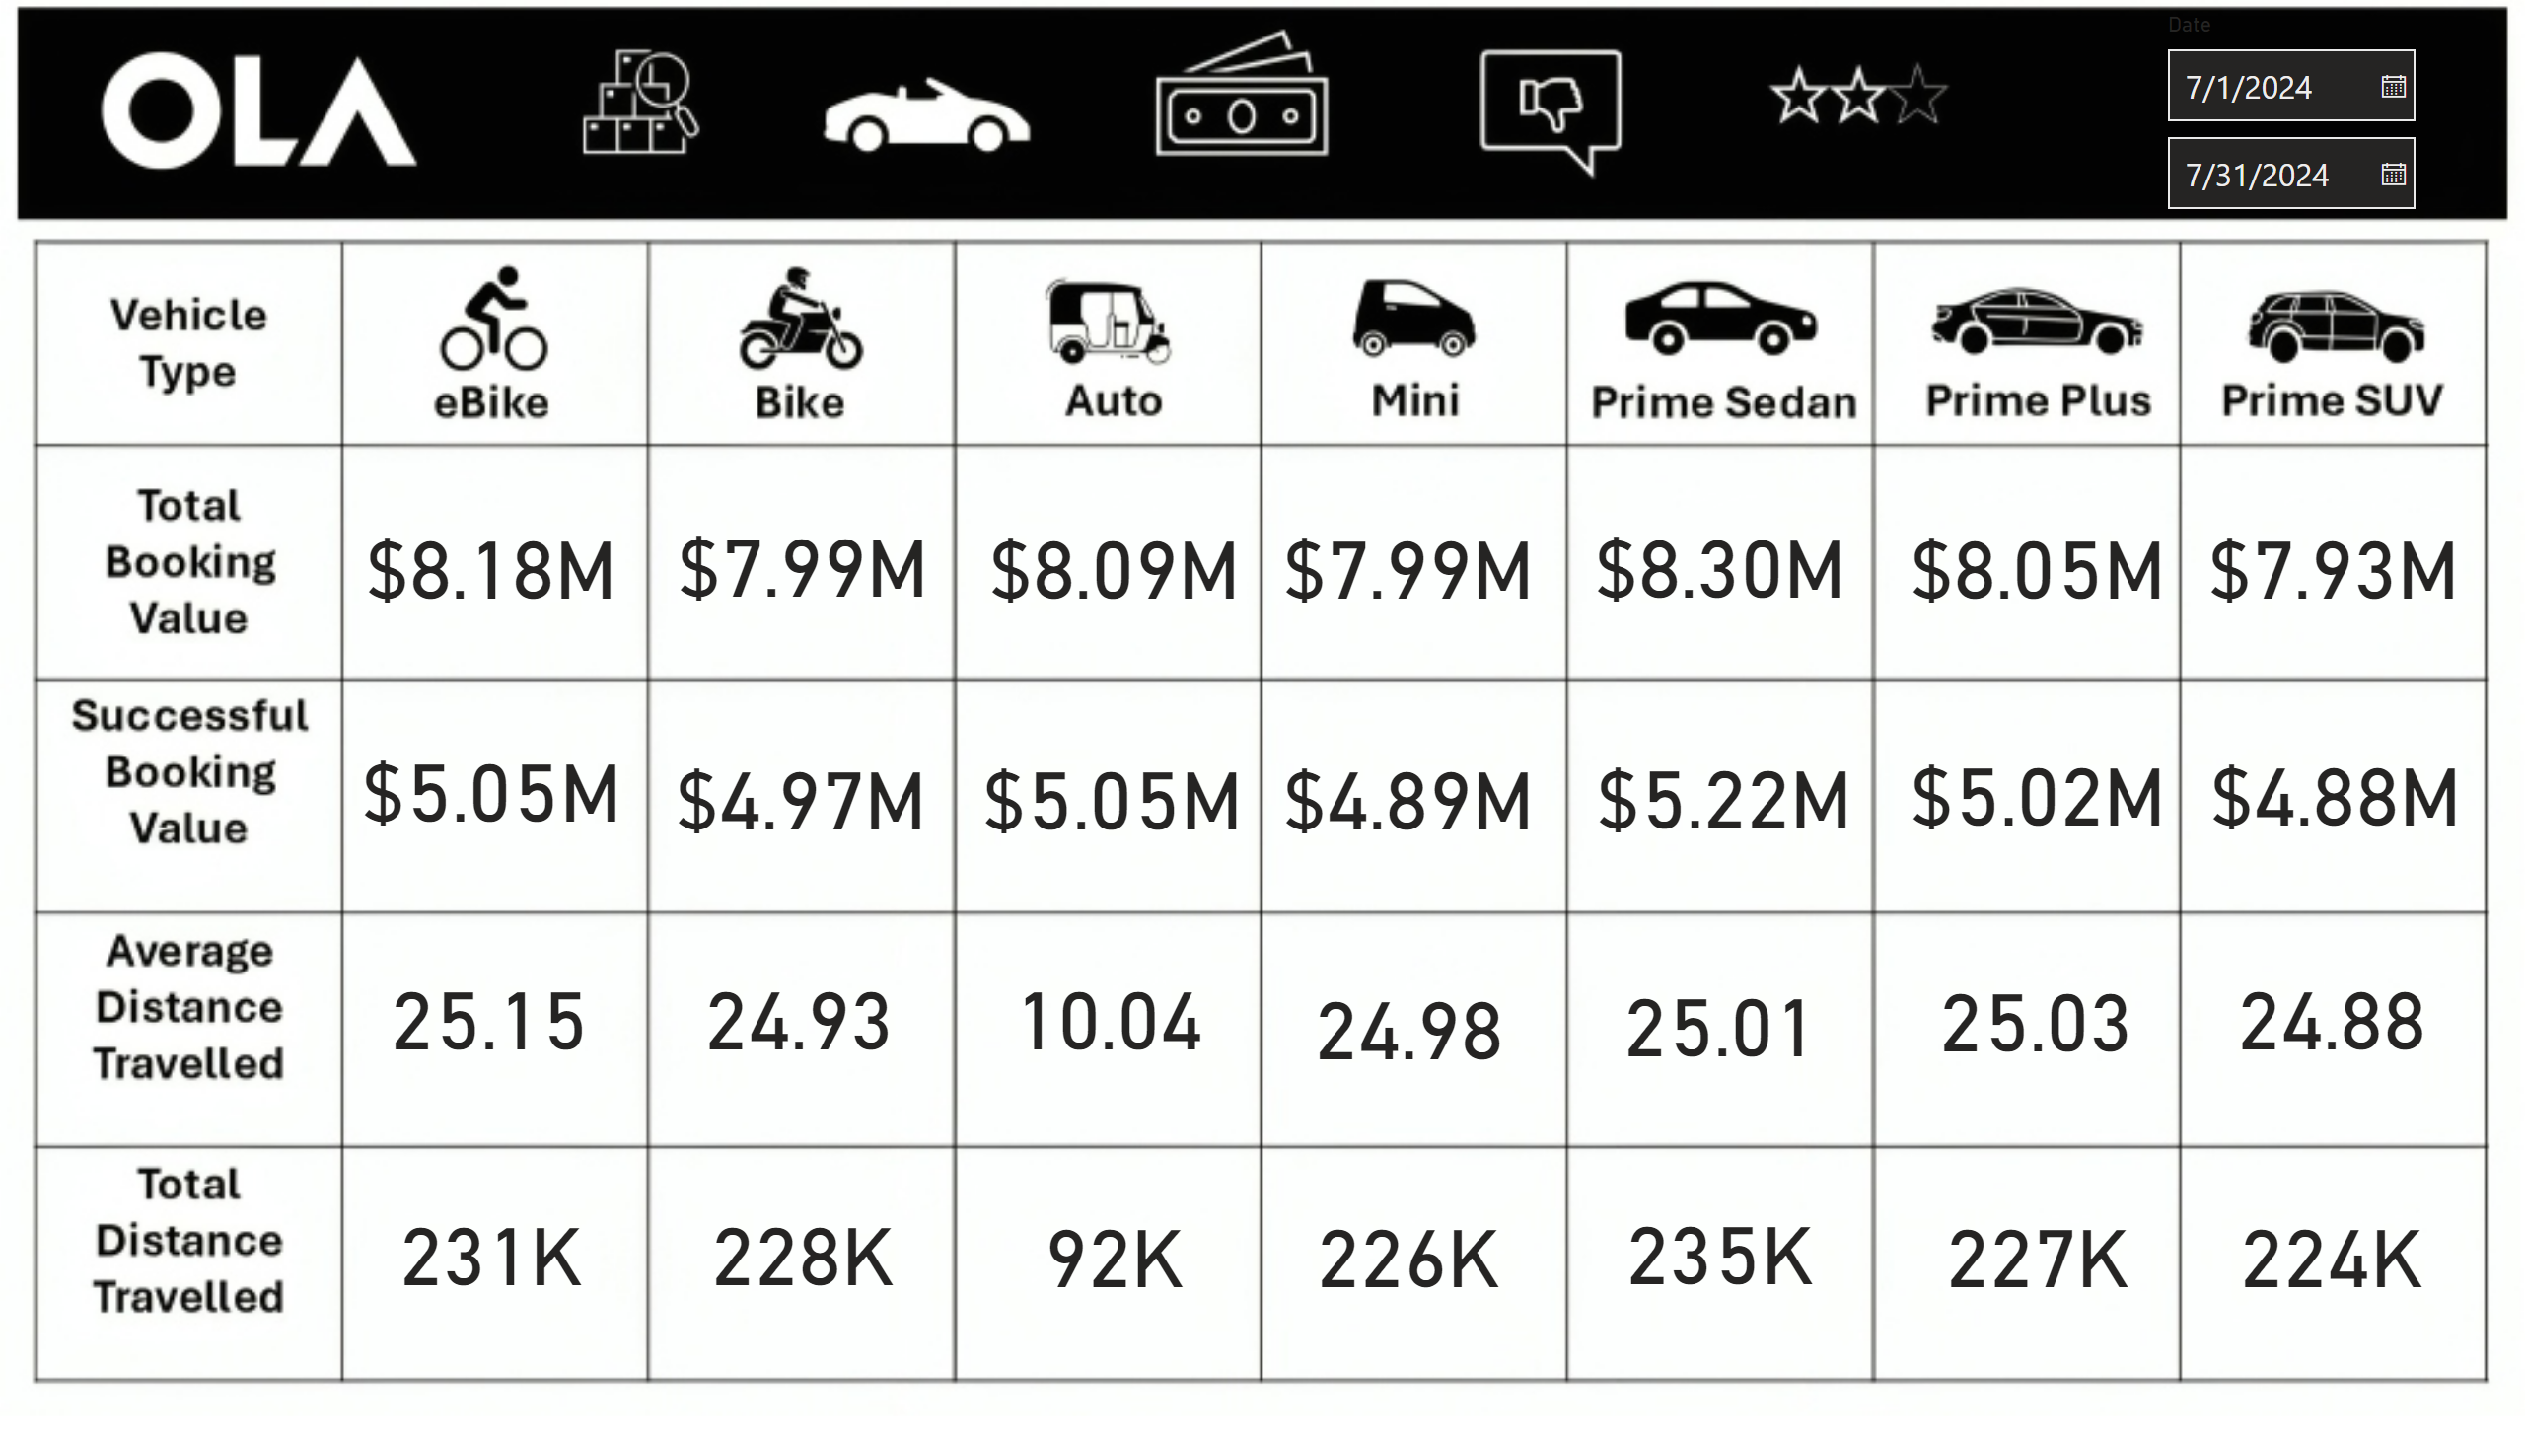
Slide 2
Notes:
actionButton
No alt text provided
actionButton
No alt text provided
actionButton
No alt text provided
actionButton
No alt text provided
card
No alt text provided
card
No alt text provided
card
No alt text provided
card
No alt text provided
card
No alt text provided
card
No alt text provided
card
No alt text provided
card
No alt text provided
card
No alt text provided
card
No alt text provided
card
No alt text provided
card
No alt text provided
card
No alt text provided
card
No alt text provided
card
No alt text provided
card
No alt text provided
card
No alt text provided
card
No alt text provided
card
No alt text provided
card
No alt text provided
card
No alt text provided
card
No alt text provided
card
No alt text provided
card
No alt text provided
card
No alt text provided
card
No alt text provided
card
No alt text provided
card
No alt text provided
slicer
No alt text provided

Slide 3
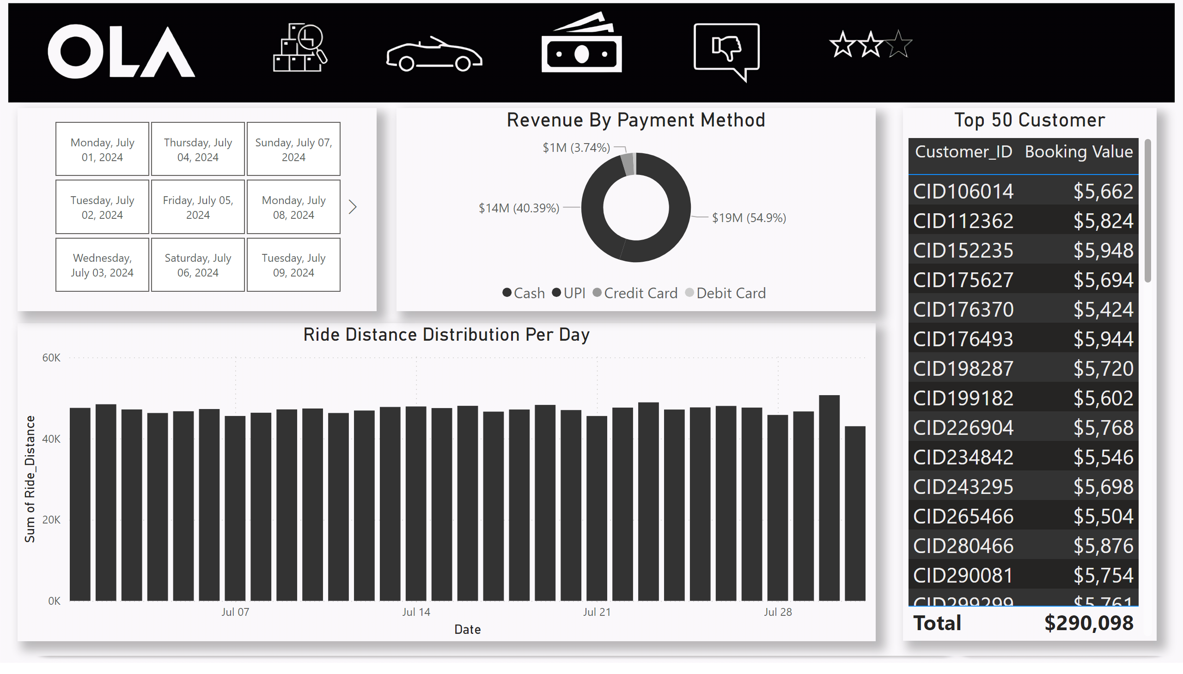
Slide 3
Notes:
actionButton
No alt text provided
actionButton
No alt text provided
actionButton
No alt text provided
actionButton
No alt text provided
Revenue By Payment Method
No alt text provided
Ride Distance Distribution Per Day
No alt text provided
slicer
No alt text provided
Top 50 Customer
No alt text provided

Slide 4
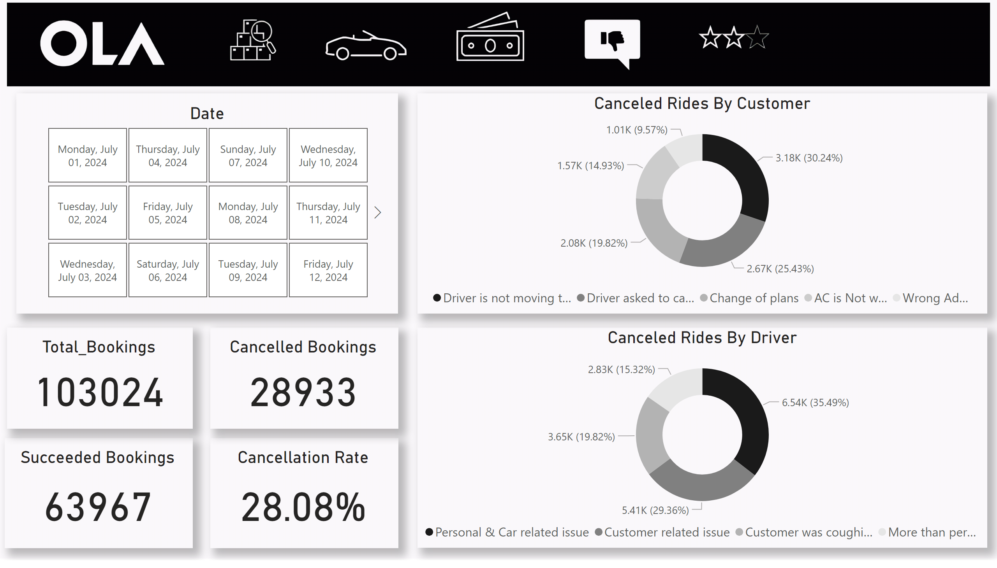
Slide 4
Notes:
actionButton
No alt text provided
actionButton
No alt text provided
actionButton
No alt text provided
actionButton
No alt text provided
Canceled Rides By Customer
No alt text provided
Canceled Rides By Driver
No alt text provided
Total_Bookings
No alt text provided
Succeeded Bookings
No alt text provided
Cancelled Bookings
No alt text provided
Cancellation Rate
No alt text provided
Date
No alt text provided

Slide 5
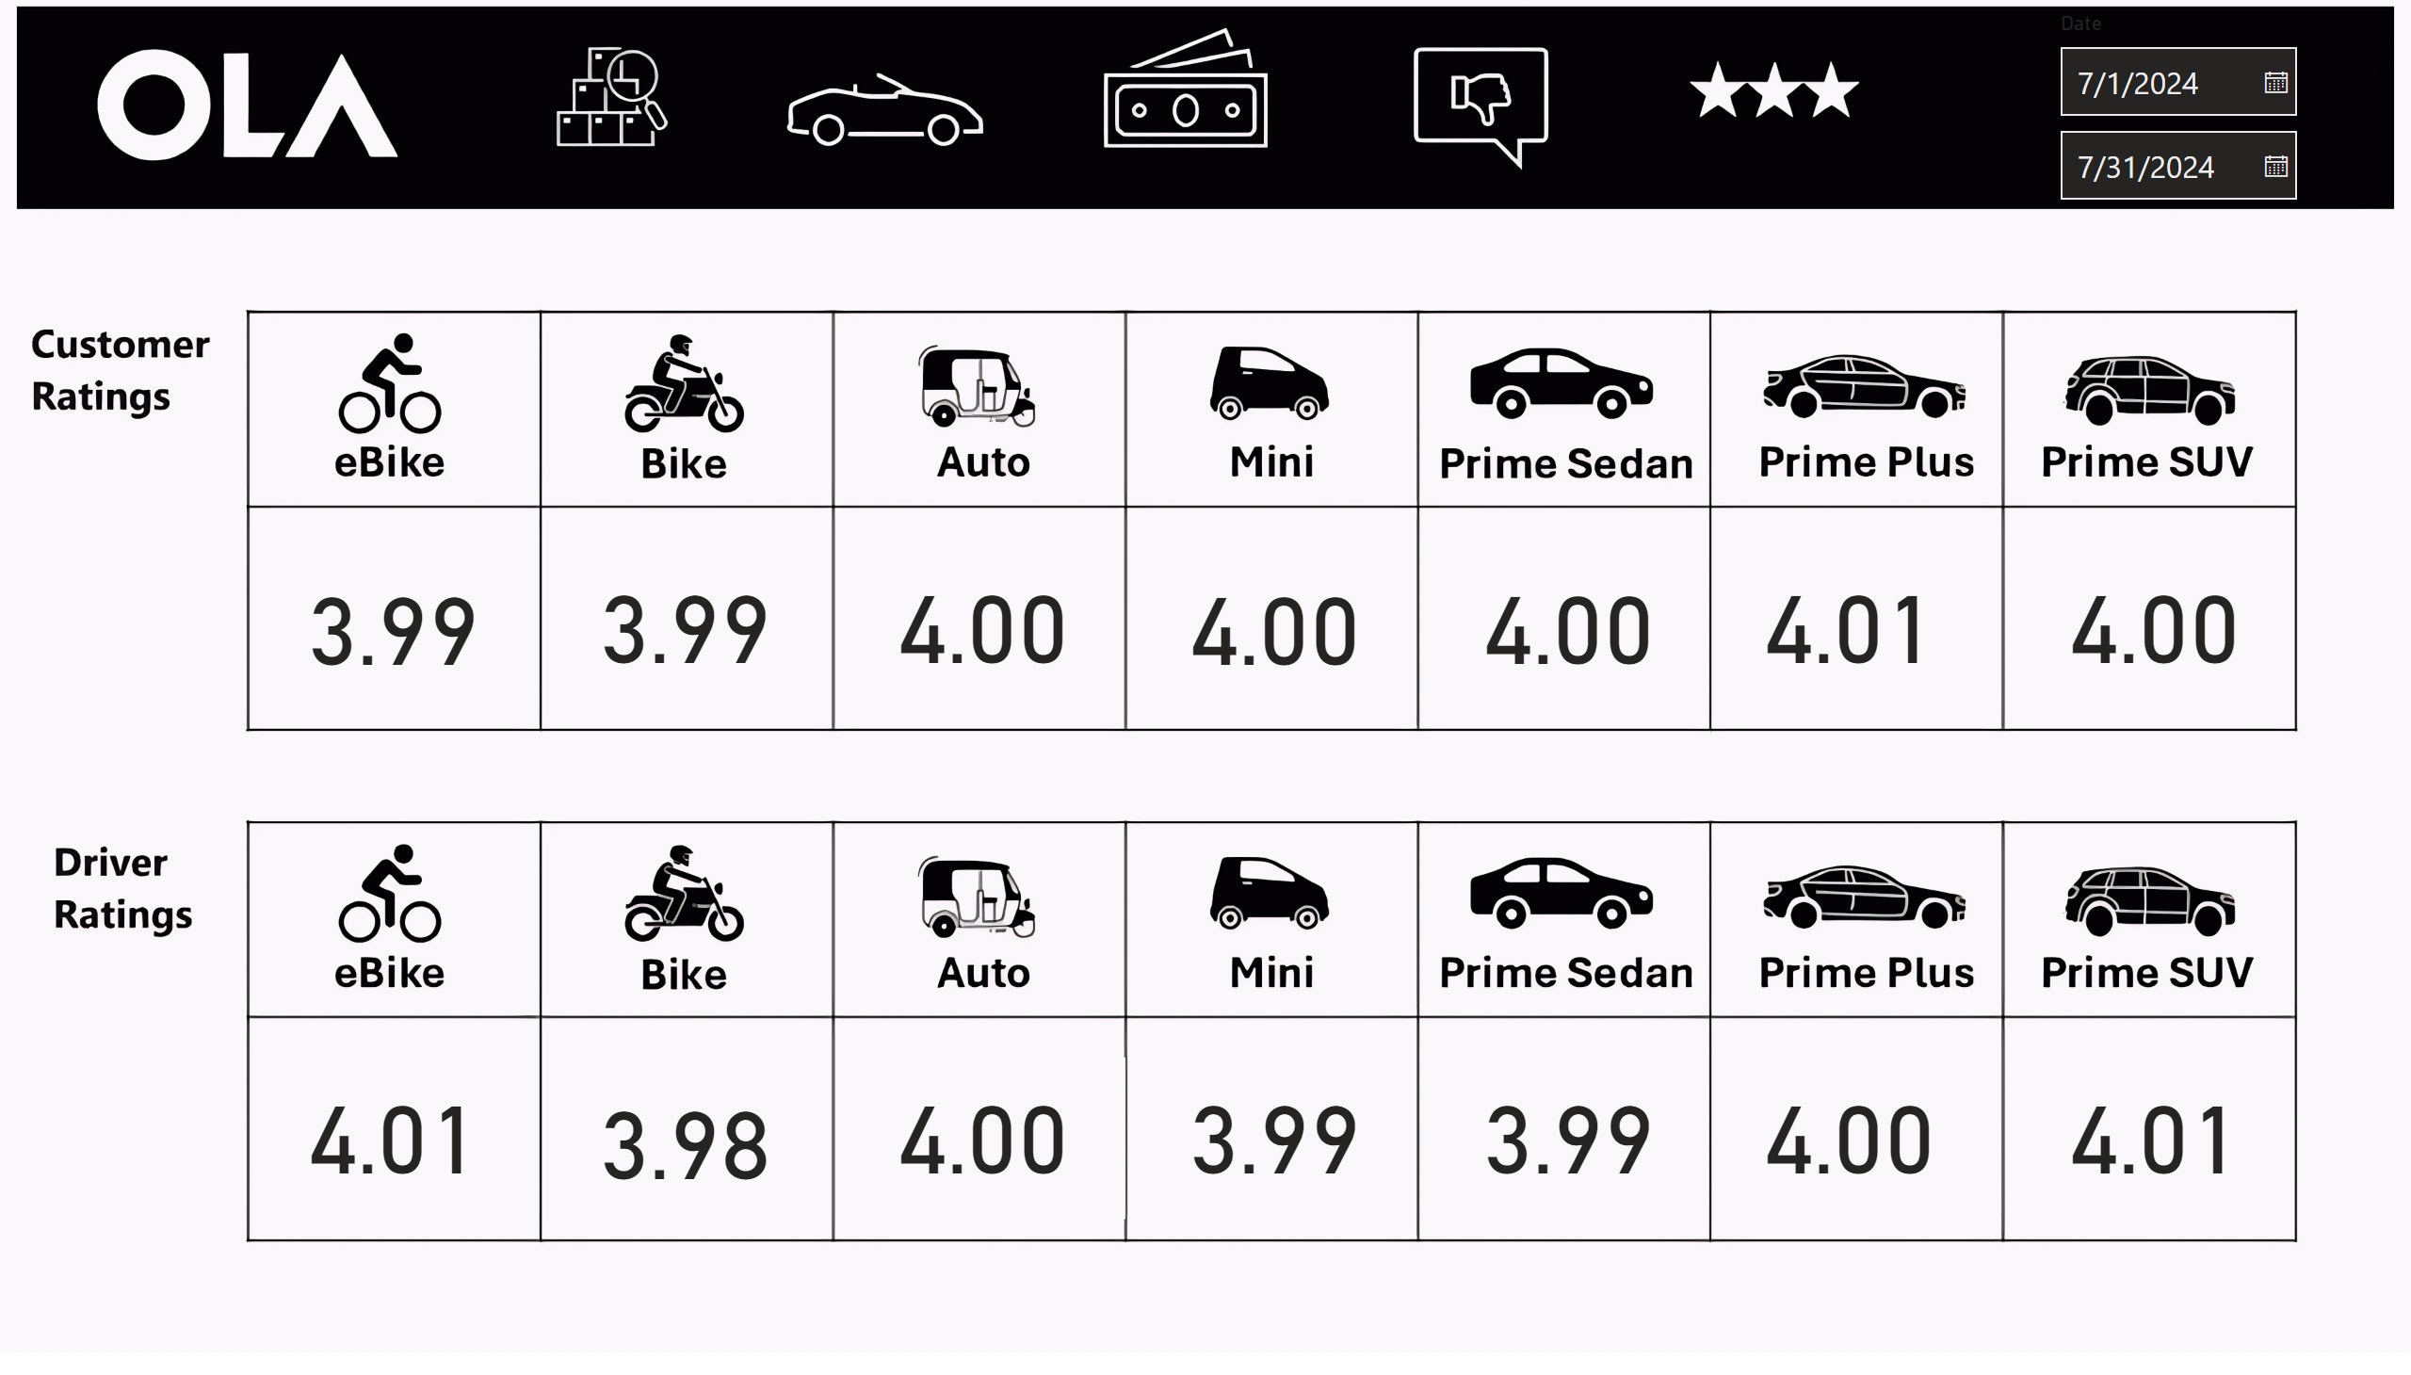
Slide 5
Notes:
actionButton
No alt text provided
actionButton
No alt text provided
actionButton
No alt text provided
actionButton
No alt text provided
card
No alt text provided
card
No alt text provided
card
No alt text provided
card
No alt text provided
card
No alt text provided
card
No alt text provided
card
No alt text provided
card
No alt text provided
card
No alt text provided
card
No alt text provided
card
No alt text provided
card
No alt text provided
card
No alt text provided
card
No alt text provided
slicer
No alt text provided

